Slide 1

Unit 02.01.03
CS 5220:
COMPUTER COMMUNICATIONS
S&W Performance, and Go-back-N ARQ
XIAOBO ZHOU, Ph.D.
Professor, Department of Computer Science

Slide 2
Stop-and-Wait Performance
Stop-and-Wait ARQ works well on channels that have low propagation delay
The protocol becomes inefficient when the propagation delay is much greater than the time to transmit a frame

Slide 3
Stop-and-Wait ARQ Efficiency
Last frame bit enters channel
ACK arrives
First frame bit enters channel
Channel idle while transmitter waits for ACK
t
A
B
t
First frame bit arrives at receiver
Receiver processes frame and
prepares ACK
Last frame bit arrives at receiver

Slide 4
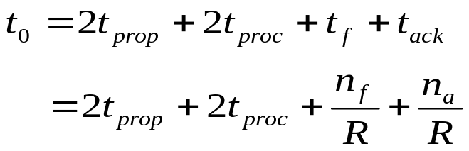
Stop-and-Wait Delay Model
      t₀ = total time to transmit 1 frame
A
t_{proc}
B
frame
t_{f} time (nf/R)
ACK
t_{prop}
t_{proc}
t_{ack} (na/R)
t_{prop}
bits/info frame
bits/ACK frame
channel transmission rate

Slide 5
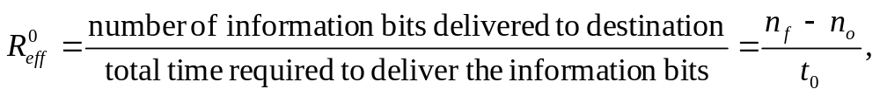
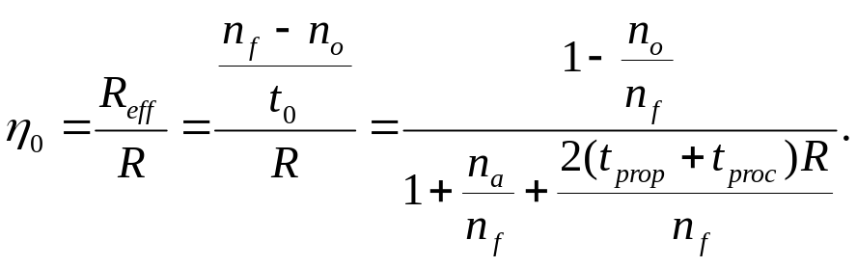
S&W Efficiency on Error-free channel
Effective transmission rate:
bits for header & CRC
Transmission efficiency:
Effect of
frame overhead
Effect of
ACK frame
Effect of
Delay-Bandwidth Product

Slide 6
Delay-Bandwidth Product
      t₀ = total time to transmit 1 frame
A
t_{proc}
B
t_{prop}
frame
t_{f} time (nf/R)
t_{proc}
t_{ack} (na/R)
t_{prop}
Delay-bandwidth product is 2( t_{prop} + t_{proc} ) * R, or RTT * R

Slide 7
Example: Impact of Delay-Bandwidth Product
n_{f}=1250 bytes = 10000 bits, n_{a}=n_{o}=25 bytes = 200 bits
2xDelayxBW Efficiency | 1 ms 200 km (RTT dist.) | 10 ms 2000 km | 100 ms 20000 km | 1 sec 200000 km
1 Mbps | 10³ 88% | 10⁴ 49% | 10⁵ 9% | 10⁶ 1%
1 Gbps | 10⁶ 1% | 10⁷ 0.1% | 10⁸ 0.01% | 10⁹ 0.001%

Slide 8
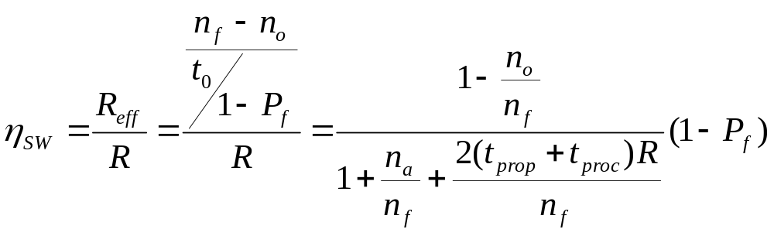
S&W Efficiency in Channel with Errors
Let 1 – P_{f} = probability frame arrives w/o errors
Avg. # of transmissions to first correct arrival is then 1/ (1–P_{f} )
“If 1-in-10 get through without error, then avg. 10 tries to success”
Avg. Total Time per frame is then t₀/(1 – P_{f})
Effect of frame loss

Slide 9
Example: Impact Bit Error Rate
n_{f}=1250 bytes = 10000 bits, n_{a}=n_{o}=25 bytes = 200 bits
Find efficiency for random bit errors with p=0, 10⁻⁶, 10⁻⁵, 10⁻⁴
1 – P_{f} Efficiency | 0 | 10⁻⁶ | 10⁻⁵ | 10⁻⁴
1 Mbps & 1 ms | 1 88% | 0.99 86.6% | 0.905 79.2% | 0.368 32.2%

Slide 10
Go-Back-N ARQ
Improve Stop-and-Wait by not waiting!
Keep channel busy by continuing to send frames
A procedure where the transmission of a new frame is begun before the completion time of the previous frame transmission is said to be pipelining.

Slide 11
Go-Back-N
Allow a window of up to W_{s} outstanding frames
  Receiver’s window size is often 1
The window size must be larger than the delay-bandwidth product to ensure that the channel is kept full
If ACK for oldest frame arrives before window is exhausted, continue transmitting
If window is exhausted, pull back and retransmit all outstanding frames

Slide 12
Go-Back-4
Go-Back-4:
4 frames are outstanding; so go back 4
fr
0
fr
1
fr
2
fr
3
fr
4
fr
5
fr
6
fr
3
fr
4
fr
5
fr
6
fr
7
fr
8
fr
9
Time
A
B
ACK1
ACK2
ACK3
out of sequence frames
ACK4
ACK5
ACK6
ACK7
ACK8
ACK9
R_{next} 0 1 2 3 3 4 5 6 7 8 9
  Frame with errors and subsequent out-of-sequence frames are ignored
  Transmitter is forced to go back when window of 4 is exhausted

Slide 13
Summary of the Lesson
Delay-bandwidth product is a key element in performance evaluation of network protocols
Stop-and-wait is only efficient if the delay-bandwidth product is very small

